Slide 1
E-Commerce Purchasing Intention Prediction
Alvin Chua

Slide 2

BUSINESS PROBLEM: INCREASE CONVERSION RATE / REVENUE

Slide 3
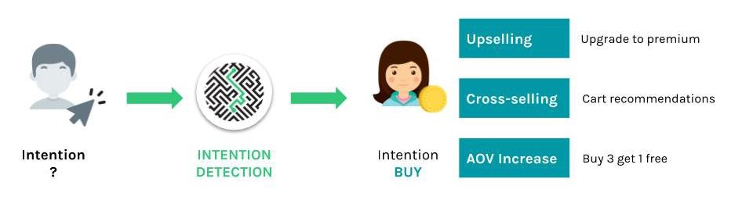
INTENTION TO BUY

Slide 4
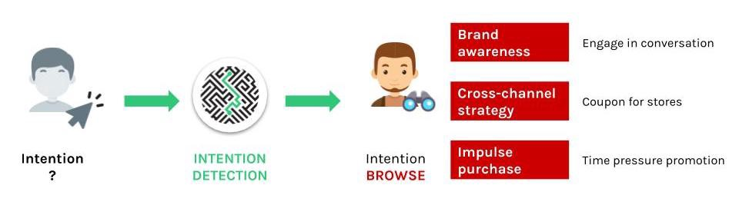
INTENTION TO BROWSE

Slide 5
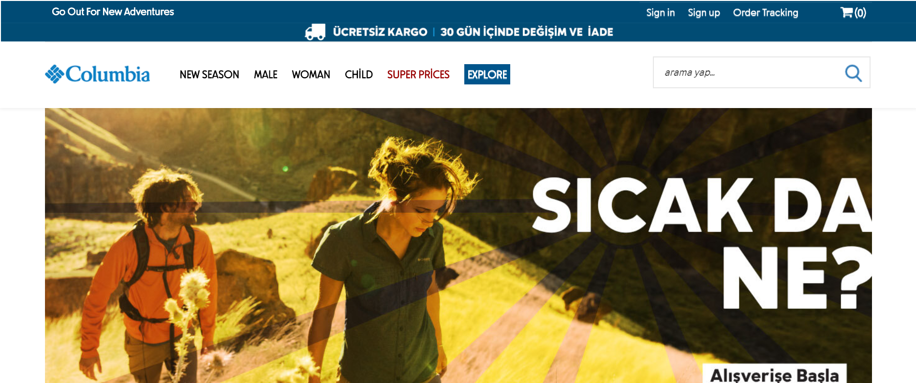
DATASET

Slide 6


DATASET SOURCE
Google Analytics data
12,330 sessions (rows) from different users
17 features
1 target (Purchase/Did not purchase)

Slide 7







FEATURE DESCRIPTION (NUMERIC)
Administrative
Page Clicks
Duration (sec)
Informational
Page Clicks
Duration (sec)
Product-Related
Page Clicks
Duration (sec)
Special Day
Page Value
Bounce Rate
Exit Rate

Slide 8

BOUNCE RATE
enters website, and leaves from landing page, without visiting anything else

Slide 9
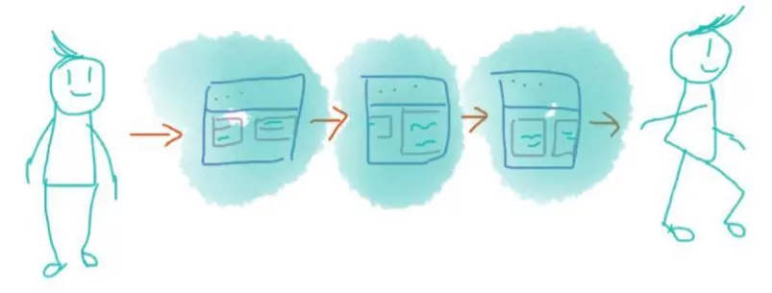
EXIT RATE
percentage of visitors who click away to a different site from a particular page, after having visited any number of pages on your site

Slide 10



FEATURE DESCRIPTION (CATEGORICAL)
Month
Visitor Type
(New, Returning, Others)
Weekend
(Yes/No)

Slide 11




MASKED FEATURES (CATEGORICAL)
OS
(8 types)
Browser
(13 types)
Region
(9 types)
Traffic Type
(20 types)

Slide 12
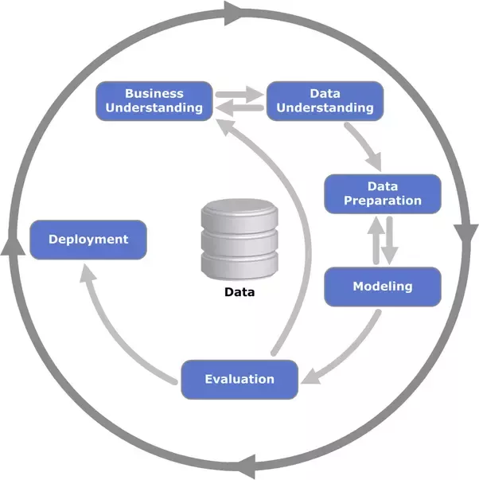
DATA SCIENCE PROJECT WORKFLOW

Slide 13
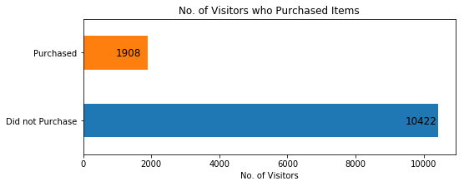
TARGET VARIABLE

Slide 14
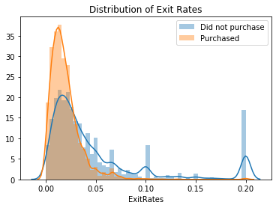

Slide 15
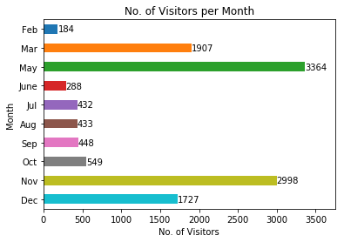

Slide 16
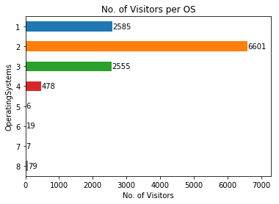




Slide 17
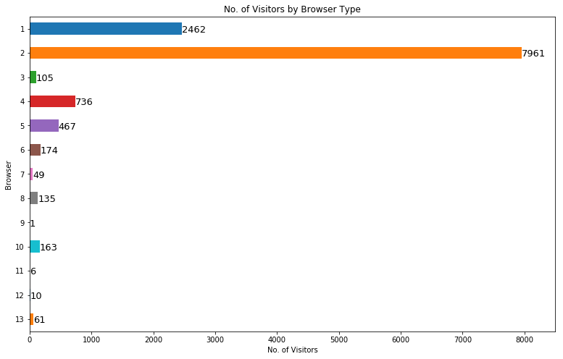



Slide 18
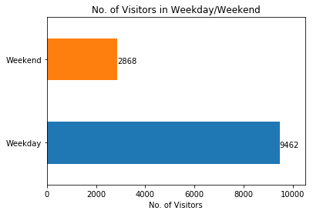

Slide 19
WORKFLOW
Feature Engineering
Data Preprocessing
Modelling

Slide 20

MODELLING

Slide 21

MODEL SELECTION
Compared scoring metrics across 9 different classification models
Chose XGBoost as final model
Highest F1 score: 66.8%
Highest Recall: 72.0%
Highest ROC AUC: 82.0%
Highest Accuracy: 88.9%

Slide 22
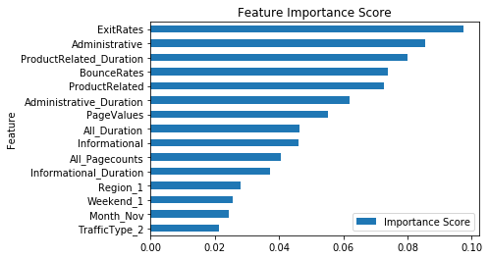
FEATURE IMPORTANCE

Slide 23
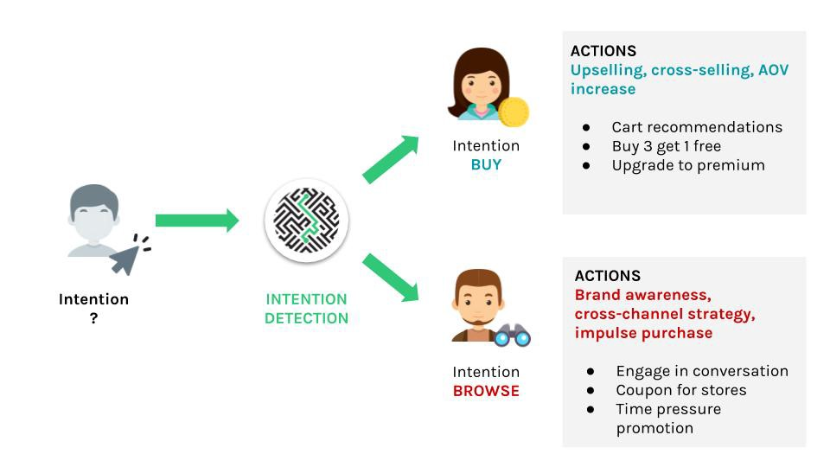
BUSINESS IMPACT
 | Predicted Non-Purchase | Predicted Purchase
Actual Non-Purchase | 1919 | 165
Actual Purchase | 109 | 273

Slide 24
LIMITATIONS
Highly masked data
Lack of geographical data
Lack of domain knowledge (marketing)
Some columns are aggregated (Google Analytics data)

Slide 25
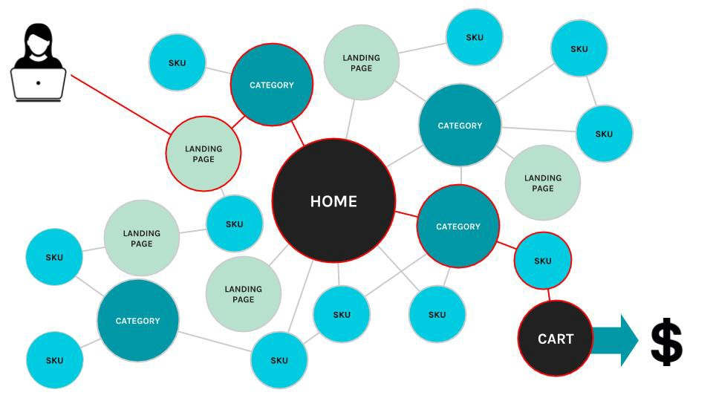
NEXT STEPS
Shopping cart abandonment problem
Request for more data from research professors

Slide 26


NEXT STEPS
Optimise current model
Possible model deployment

Slide 27
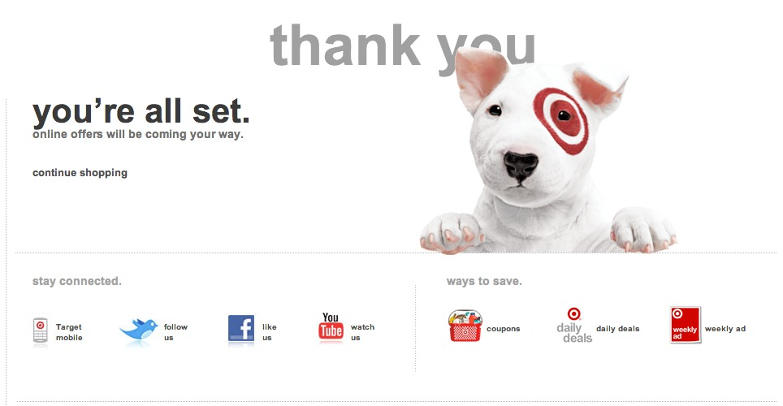
ANY QUESTIONS?

